Slide 1
Virtual Travel Guide (E-Bot) –A Detailed Information For Our Indian Monuments.
DOMAIN : MOBILE APPLICATION
PROJECT GUIDE: Batch no: 10
Mrs.S.T.Santhanalakshmi.,M.Tech(IT)., Ruth Mariya S -211417104227
Assistant Professor (Grade 1), Shaini A Ravi - 211417104251
Department of CSE.

Slide 2
INTRODUCTION
Generally when we travel or go for a tour to any place we need to hire a travel guide to provide the information regarding the tourist spot.
Rather than a travel guide, we can also google the information regarding the same which also requires zero cost but data charges apply.
To overcome such troubles where we need to hire a travel guide or google for the information, the Virtual Travel Guide Application can be used which provides the detailed information regarding the tourist place present in India like the history about the place, what’s it famous for nearby hotels or restaurants to stay in and for food, the details about the ticket fare for that particular tourist spot if required, to know about the weather condition of the spot you’re going to tour and so on.
This application also includes a ChatBot where the user related queries can be clarified, the FAQs regarding the tourist spots . Main goal of this project is to help the tourists to travel on their own and take full advantage of the visit.

Slide 3
LITERATURE REVIEW
YEAR | TITLE | AUTHORS | DESCRIPTION | ADVANTAGES | DISADVANTAGES
2013 | Smart Travel Guide: Application for Android Mobile | Dadape Jinendra R, Jadhav Bhagyashri R, Gaidhani Pranav Y, Vyavahare Seema U, AchaliyaParag N. | The propose of the architecture of mobile tourist guide system for Android Mobile Phones that is able to provide tourism information to the mobile users conveniently. | The system takes advantage of light-weighted mashup technology that can combine more than one data sources to create value-added services, while overcomes the limitations of mobile devices. | The application only contains the tourist-spot related information. User-related queries regarding the spot is still unresolved.
Journal Name : International Journal of electronics, Communication & Soft Computing Science & Engineering

Slide 4
LITERATURE REVIEW(Cont.)
YEAR | TITLE | AUTHORS | DESCRIPTION | ADVANTAGES | DISADVANTAGES
2016 | An e-business chatbot using AIML and LSA. | N. T. Thomas | The e-business has completely changed the way of selling the products using the chatbot which automatically gives immediate response to the users. | ChatBots imitate natural language to communicate with humans through a conversational interface and automated social users. | Chatbots are known for being infamous because of their inability to make decisions
Journal Name : 2016 International Conference on Advances in Computing, Communications and Informatics (ICACCI).

Slide 5
LITERATURE REVIEW(Cont.)
YEAR | TITLE | AUTHORS | DESCRIPTION | ADVANTAGES | DISADVANTAGES
2017 | A review of technologies for conversational systems. | Julia Masche, Nguyen-Thinh Le | To present the review of the development of conversational system regarding technologies and there special features including language tricks. | Chatbots can help you gather precious data from your customers by interacting with them. | Chatbot has no emotions.
Journal Name : International Conference on Computer Science, Applied Mathematics and Applications.

Slide 6
LITERATURE REVIEW(Cont.)
YEAR | TITLE | AUTHORS | DESCRIPTION | ADVANTAGES | DISADVANTAGES
2003 | Developing a Location Based Tourist Guide Application. | Todd Simcock, Stephen Peter Hillenbrand, Bruce H.Thomas | It presents the development of the Tourist Guide, a location based tourist guide application for the outdoor environment. | Simple and easy to use. | Lack of flexibility.
Journal Name : ACSW Frontiers 2003, 2003 ACSW Workshops - the Australasian Information Security Workshop (AISW) and the Workshop on Wearable, Invisible, Context-Aware, Ambient, Pervasive and Ubiquitous Computing (WICAPUC), Adelaide, South Australia, February 2003.

Slide 7
LITERATURE REVIEW (CONT.)
YEAR | TITLE | AUTHORS | DESCRIPTION | ADVANTAGES | DISADVANTAGES
2010 | Research on virtual tourist guide training system based on virtual reality technology | Minli Dai, Defu Zhou, Binbin Shi, Min wang, Liang Zhang, Caidong Gu. | This system has introduced the developing technology and procedure of virtual tourist guide system. | Minimizes the cost of hiring a travel guide. | Lacks user friendly interaction.
Journal Name : Knowledge Acquisition and Modeling (KAM), 2010 3rd International Symposium.

Slide 8
PROBLEM STATEMENT
Usually when we go for a trip to unknown places, we require travel guides to guide us ( tourists ).
The travel guide gives us the history and information about the tourist spot. In modern days, we require no travel guide since we have internet all the information is available on the internet.
The thing is you have to search for each and every detail about the tourist spot. To overcome such troubles we have developed an Virtual Travel Guide Application which can be used to provide the detailed information regarding the tourist place.
Only location services requires data charges. The FAQS regarding the tourist spot is cleared by the use of the chat bot provided in the application.
What else does a tourist need? Nearby restaurant details? Weather related information regarding the tourist spot? Yes, these details regarding the tourist spot is also available in our application. Therefore this application is a perfect fit to the tourists out there.

Slide 9
TECHNOLOGY STACK
HARWARE REQUIREMENTS
Processor : Intel Pentium Dual Core 2.00GHz
Hard disk : 500 GB
RAM : 8 GB (minimum)
SOFTWARE REQUIREMENTS
Android Studio
Java

Slide 10
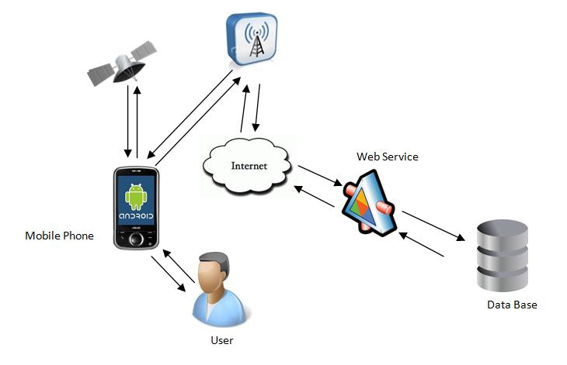
SYSTEM ARCHITECTURE

Slide 11
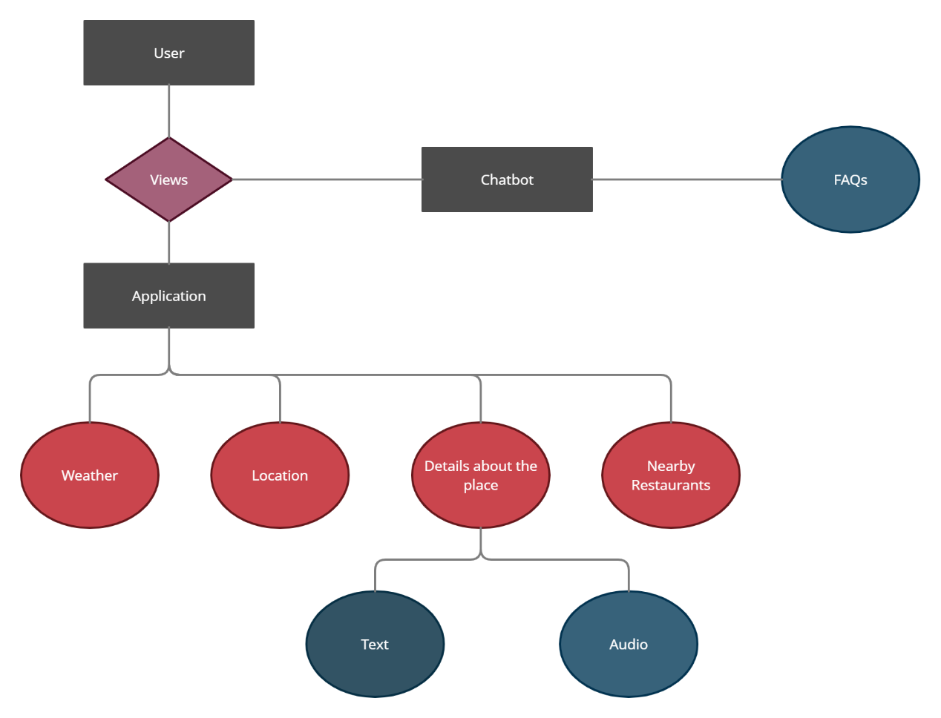
ER DIAGRAM

Slide 12
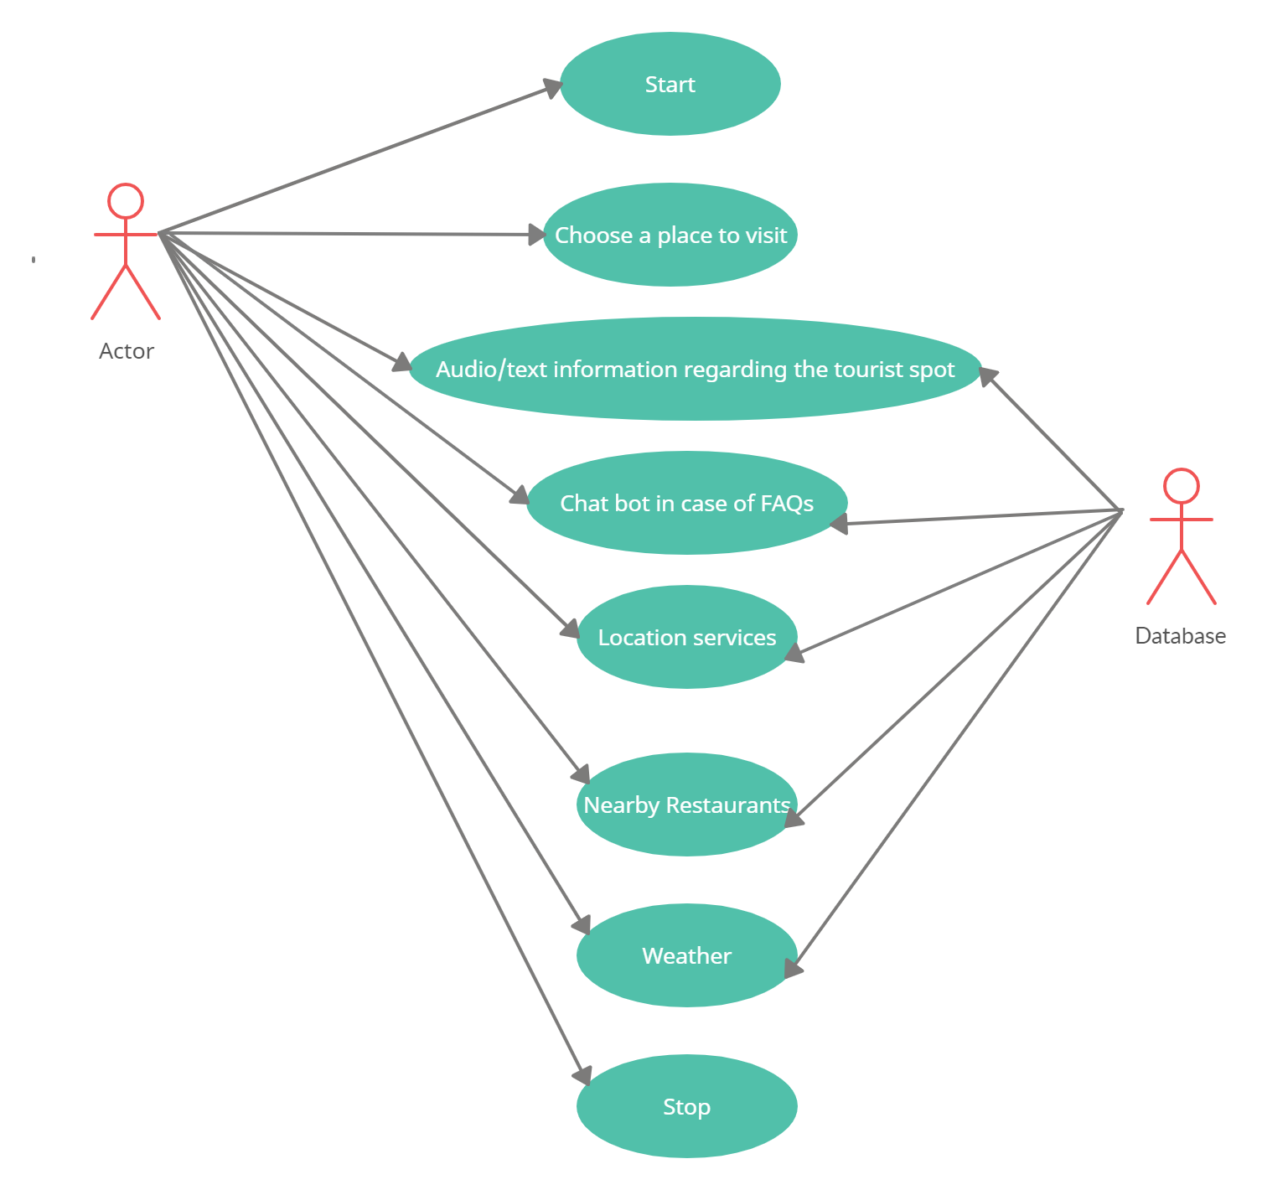
USE CASE DIAGRAM

Slide 13
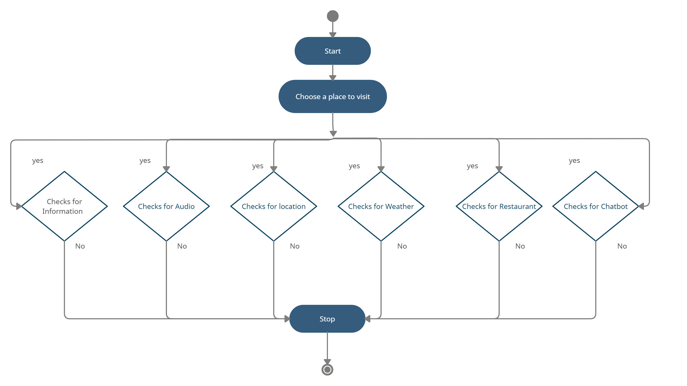
ACTIVITY DIAGRAM

Slide 14
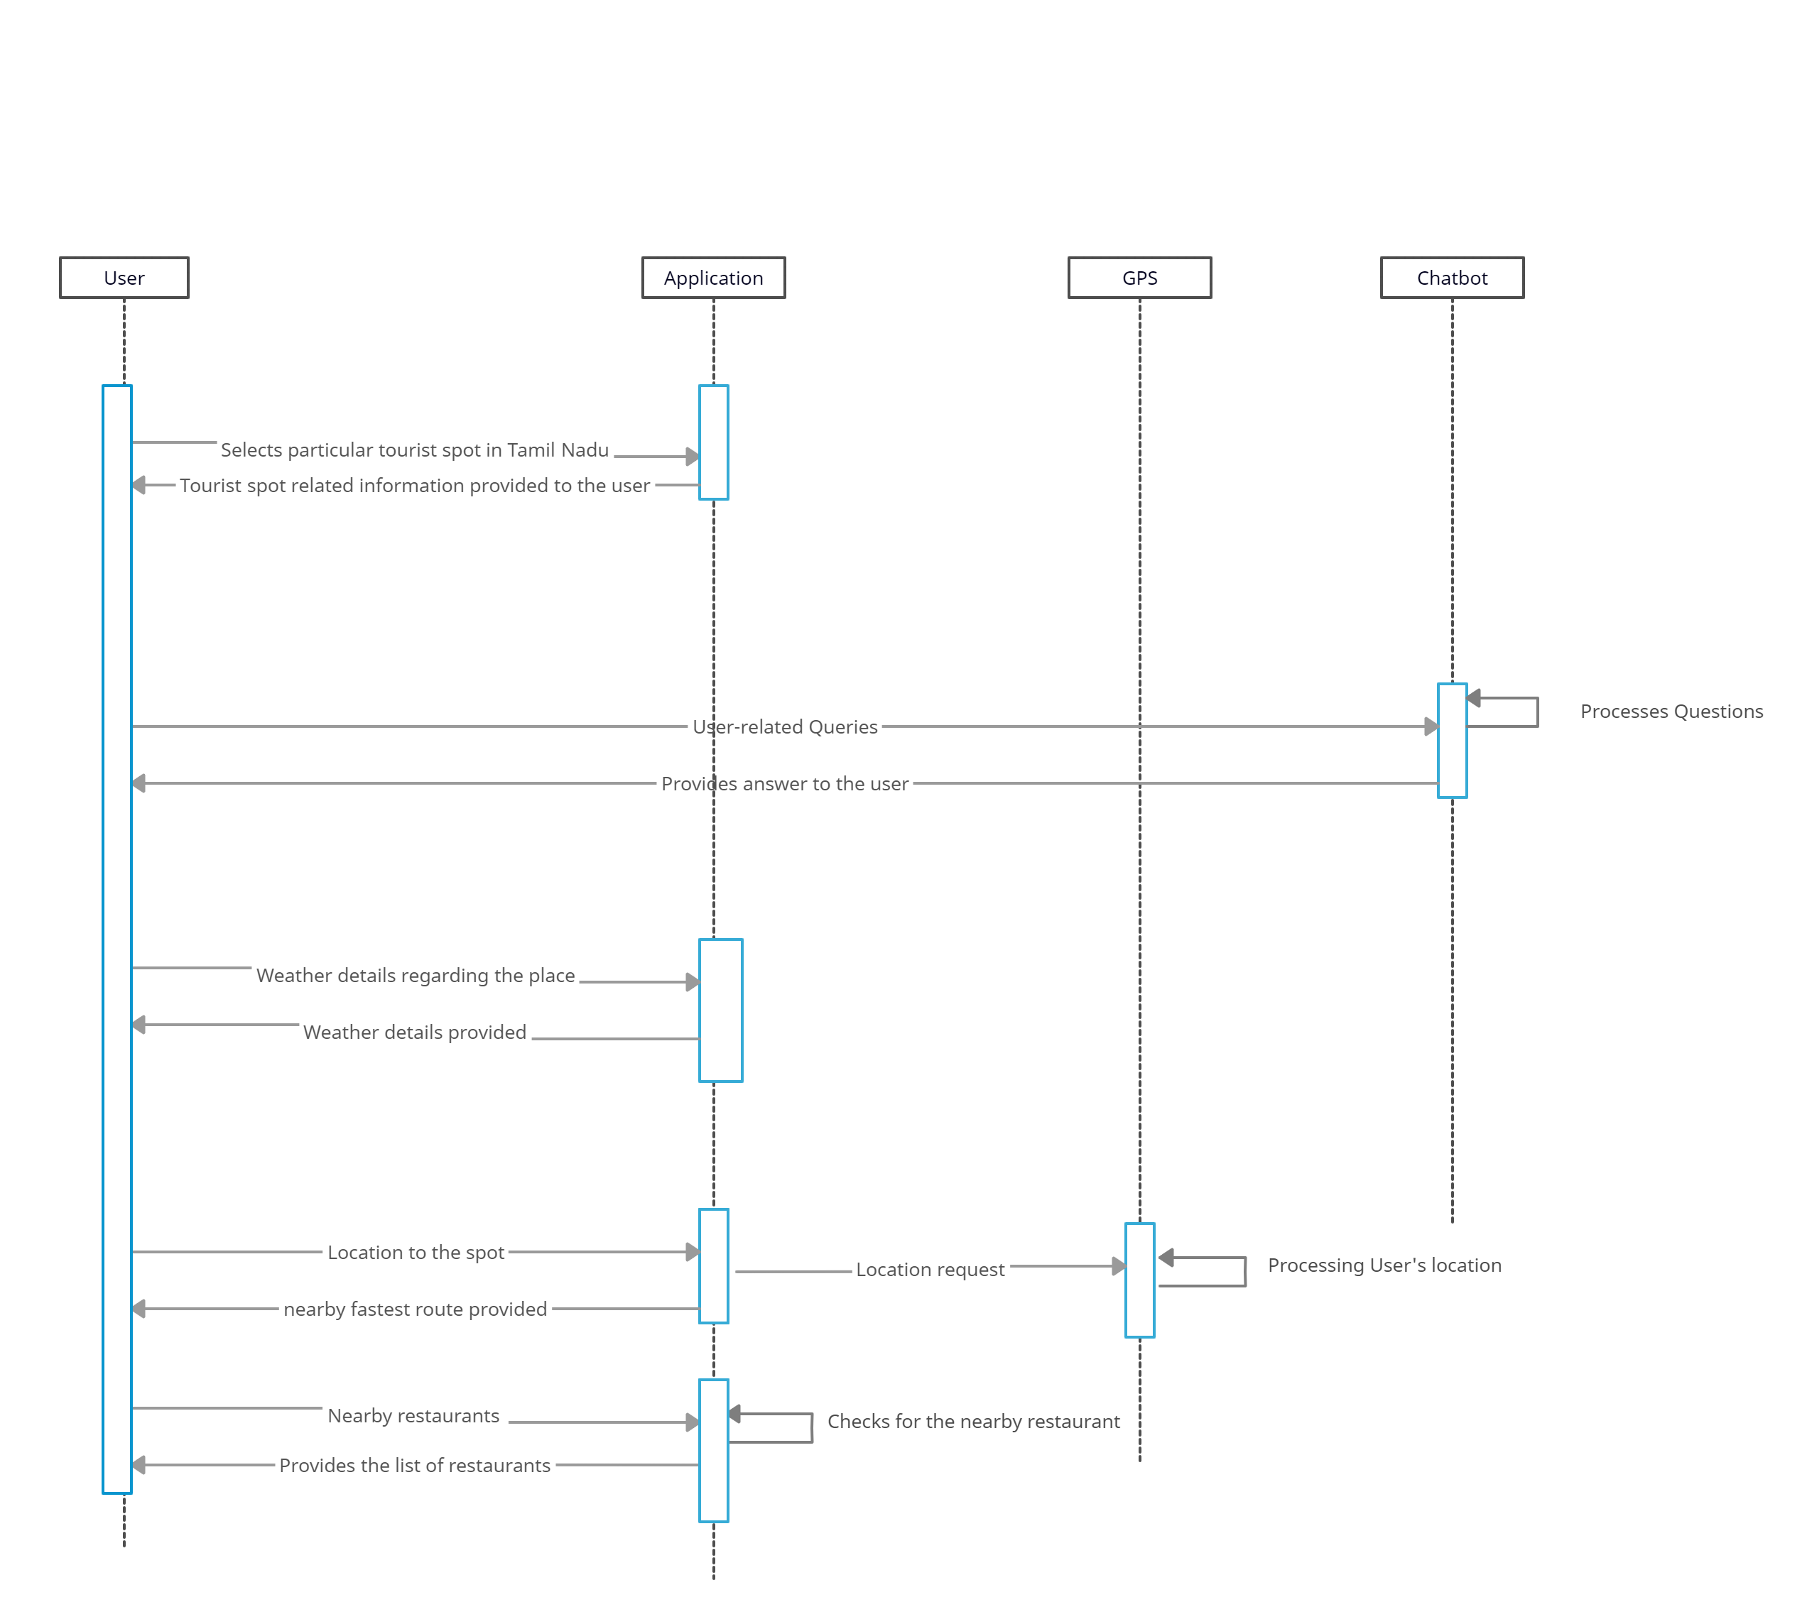
SEQUENCE DIAGRAM

Slide 15
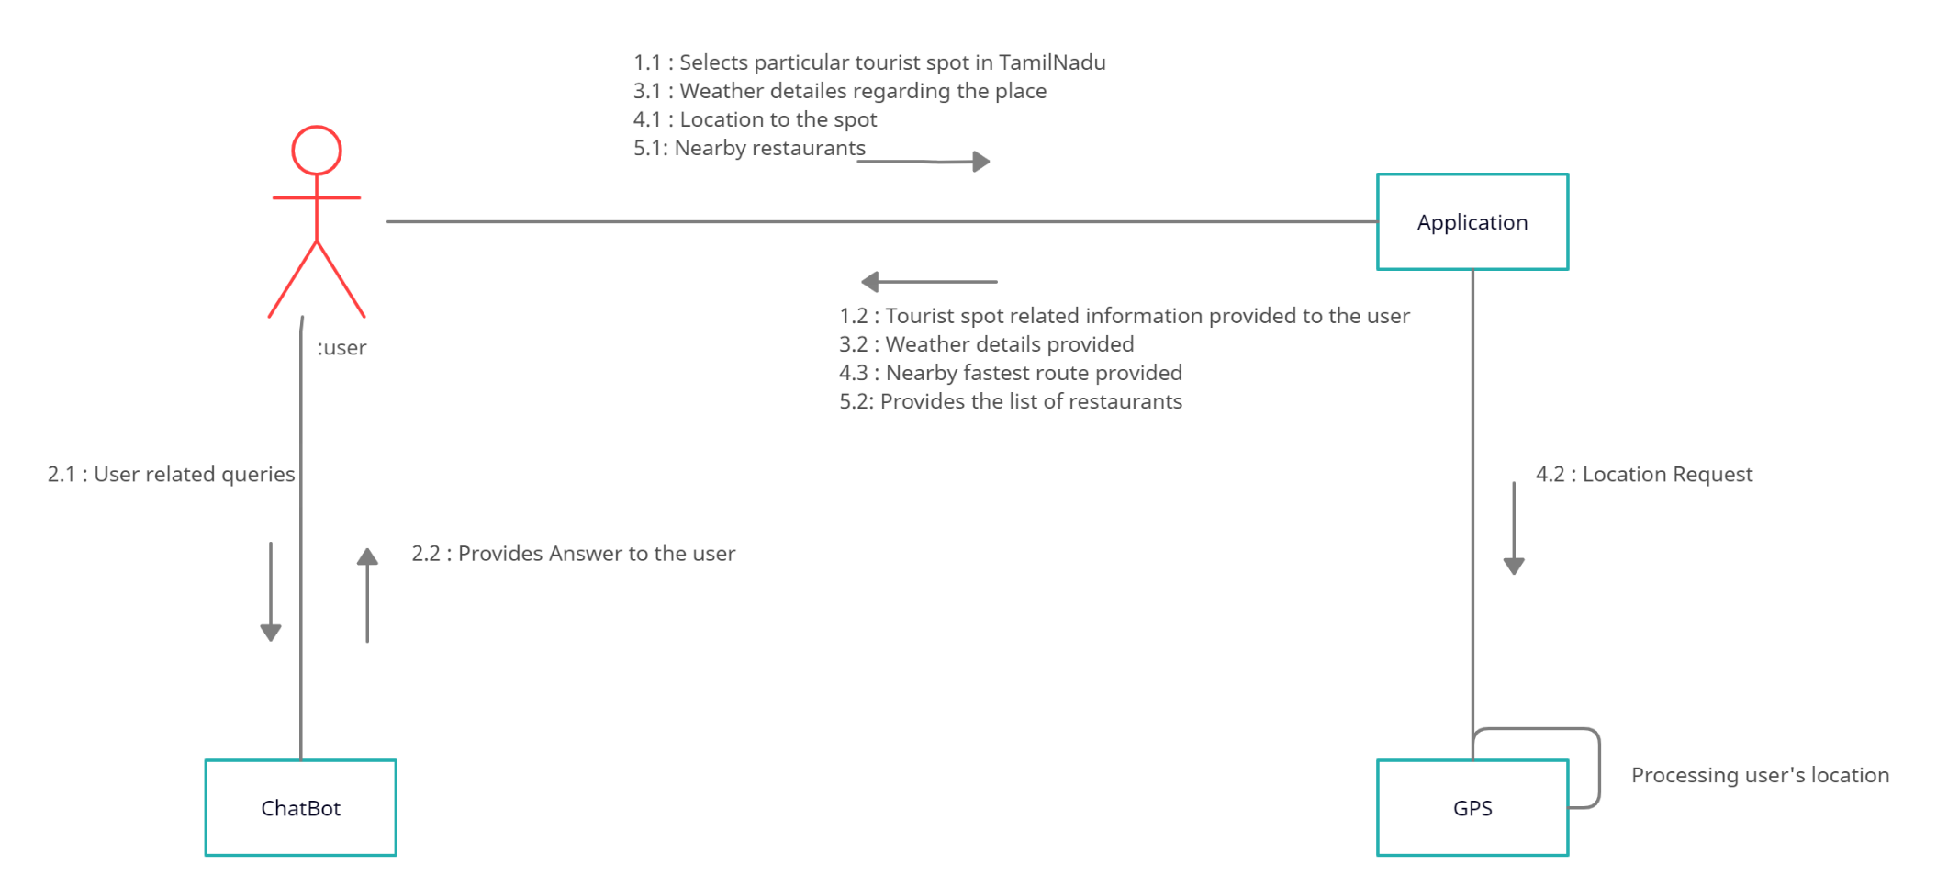
COLLABORATION DIAGRAM

Slide 16
MODULES
There are about 6 modules used in the development of the project. They are as follows:
Tourist place information
Audio
Location (Map)
Chat bot
Weather
Restaurant

Slide 17
Tourist Place Information :
In this module the information about the tourist places are given i.e., the history of the places or the information regarding the places. Also there is a chat bot to clear the users doubt regarding the places. For example to look for the nearby hotel, the user can chat with the chatBot to know the details. Thus providing the entire detail regarding the spot including the surrounding details. The advantages of the system is it is user-friendly, interactive, supports security and compatible to various web servers but the system provides information to tourists, thus reducing the stress at which tourists seek for information on the system.
Audio:
This provides the voice output where the details of the tourist spot is voiced out. With audio autoplay, you can focus on your surroundings. Put in your headphones, tap on Audio button, and let audio guide you. Later multiple language audio output feature can also be added to this application.
Location (Map):
This provides the map wherein the user can locate the easiest route to the tourist spot. Besides this is an user friendly application which requires no login and easy use of the application.

Slide 18
CHAT BOT:
Chat bot are there to clear the users doubt regarding the places. For example to look for the nearby hotel, the user can chat with the chatBot to know the details. Thus providing the entire detail regarding the spot including the surrounding details.
WEATHER :
This provide details about the weather condition in the place where the tourist spot is located. By knowing this, the traveler can plan their travel accordingly and get prepared for their tour.
RESTAURANT:
In this module the user can get to know the nearby available restaurants details around the tourist spot just by using the application and need not search for hotels/restaurants manually.

Slide 19
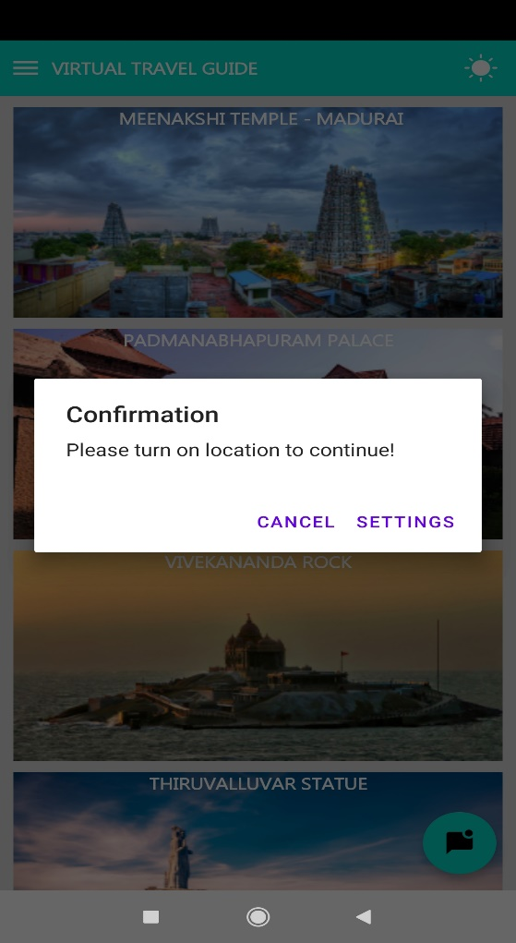
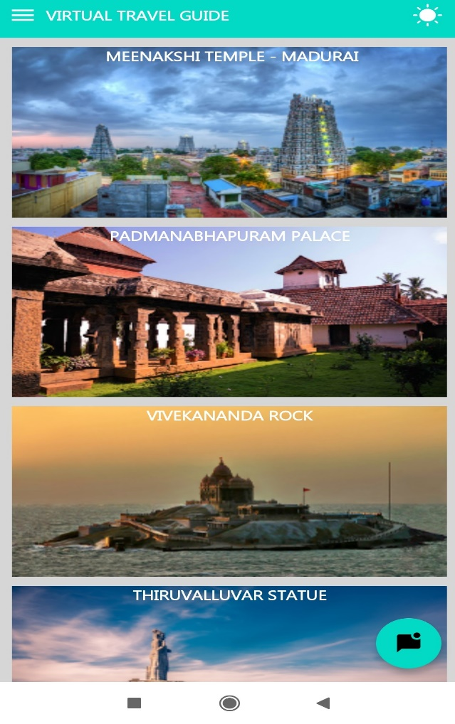
TEST REPORT
Location and network access Tourist Spots
is required to continue

Slide 20
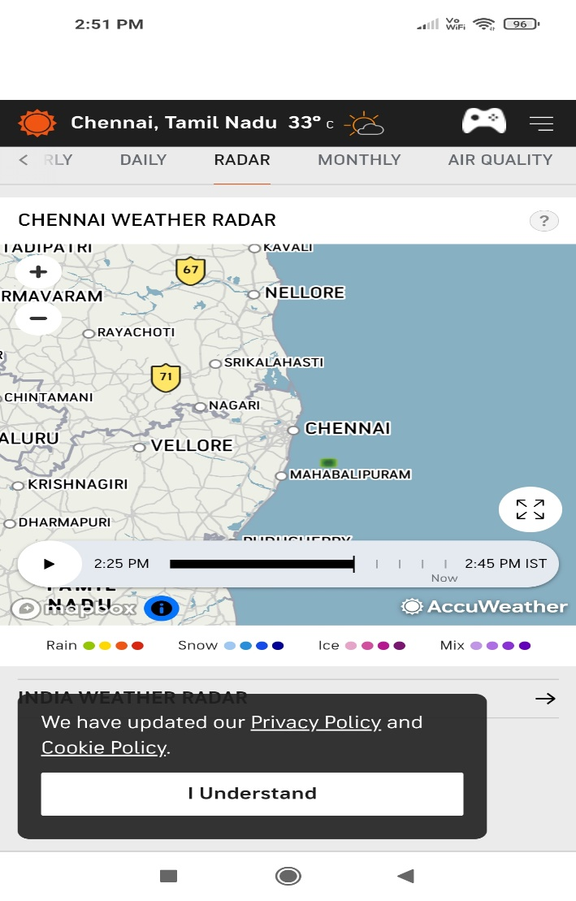
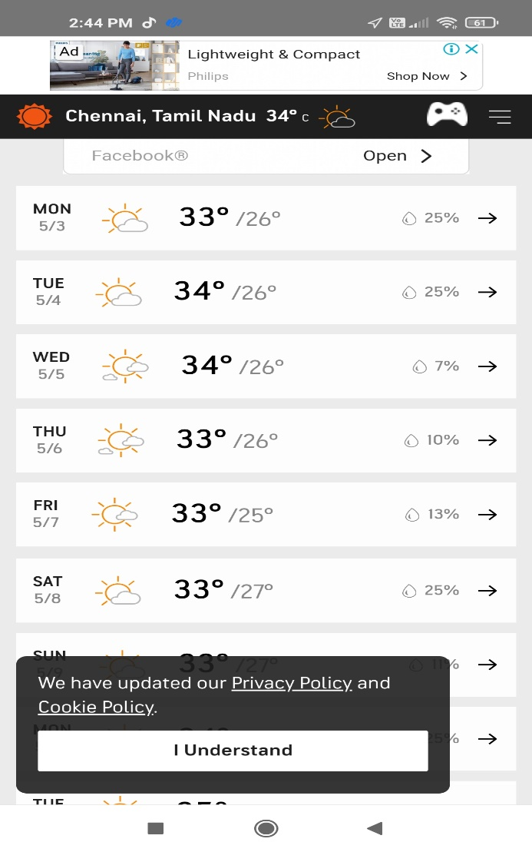
Invalid Data for Weather Weather Report

Slide 21
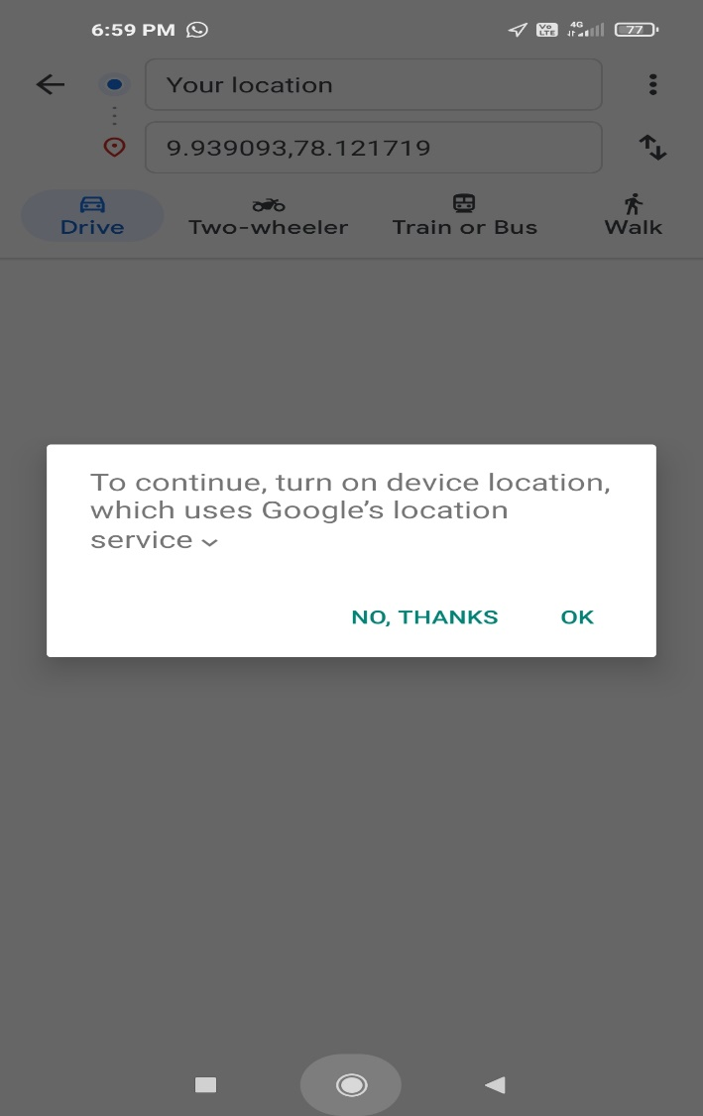
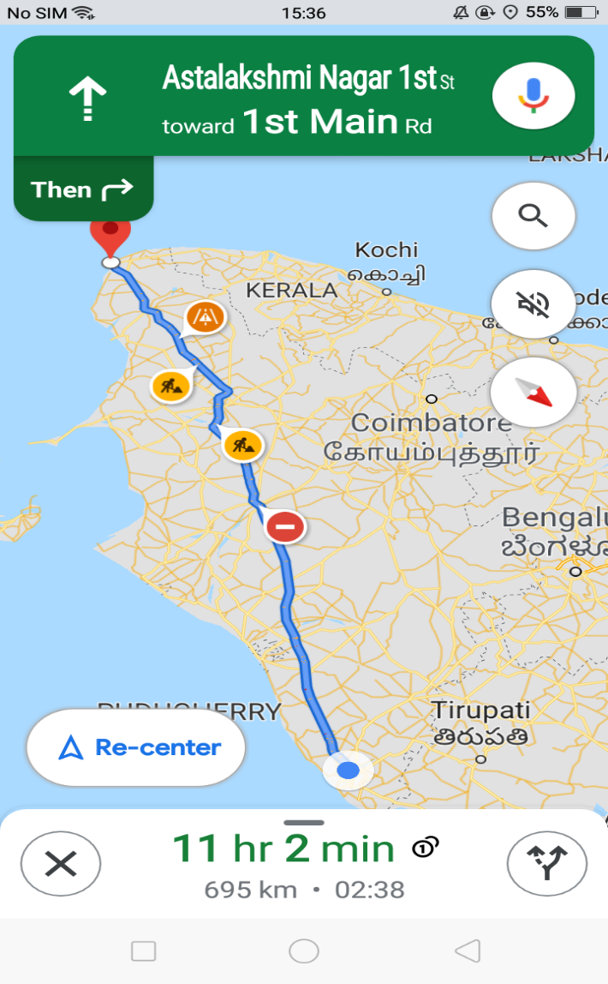
Invalid Data for Location Route Map

Slide 22
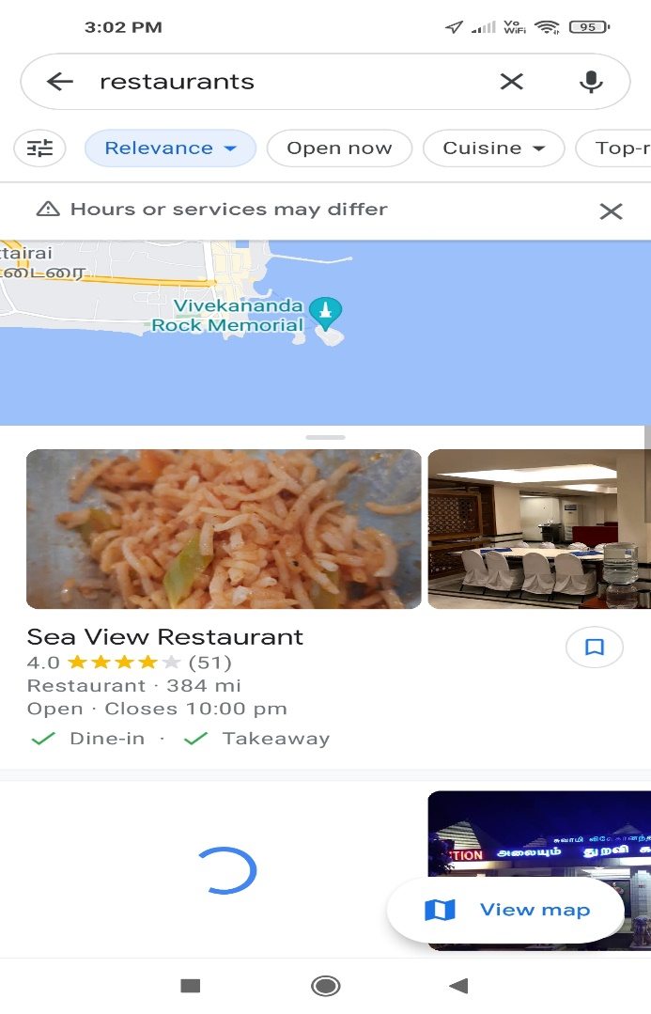
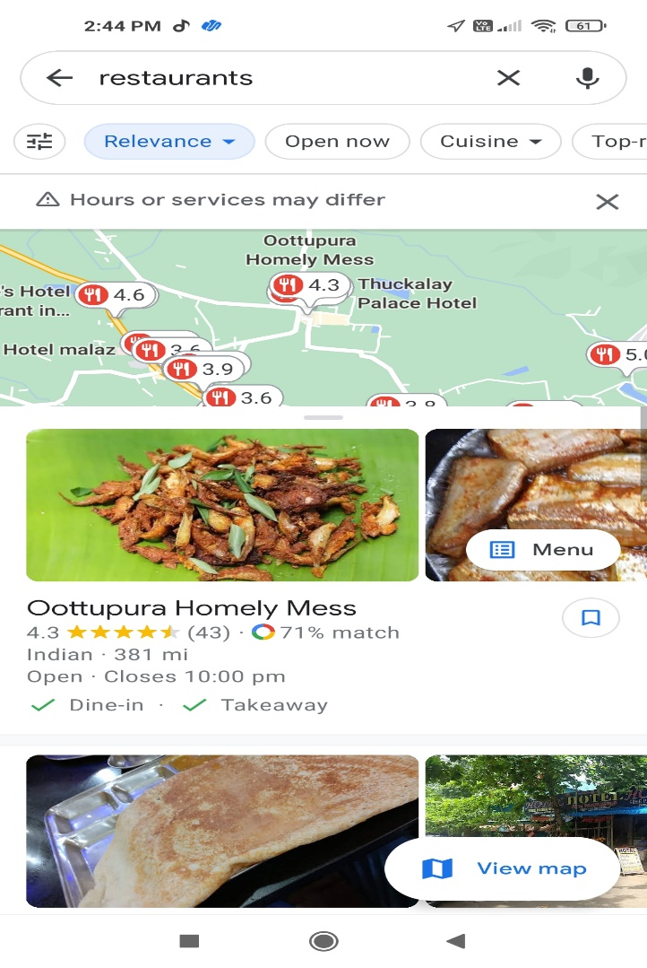
Network access is required Nearby Restaurants

Slide 23
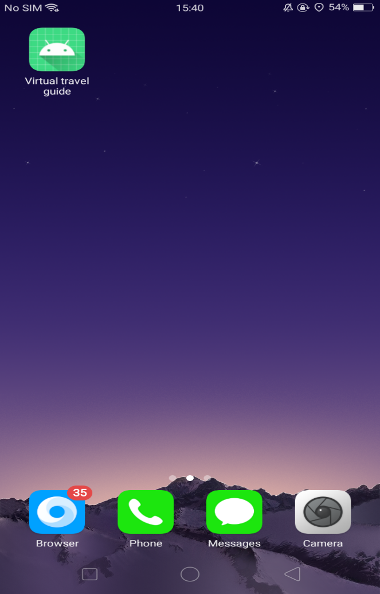
SCREENSHOTS
APPLICATION :

Slide 24

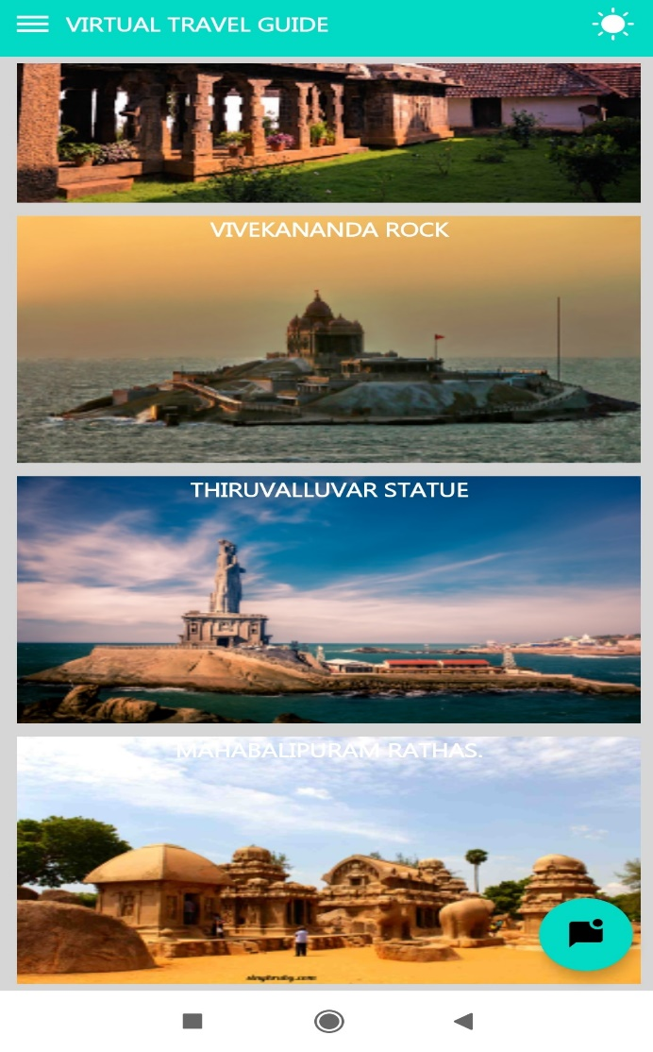
TOURIST PLACES:

Slide 25
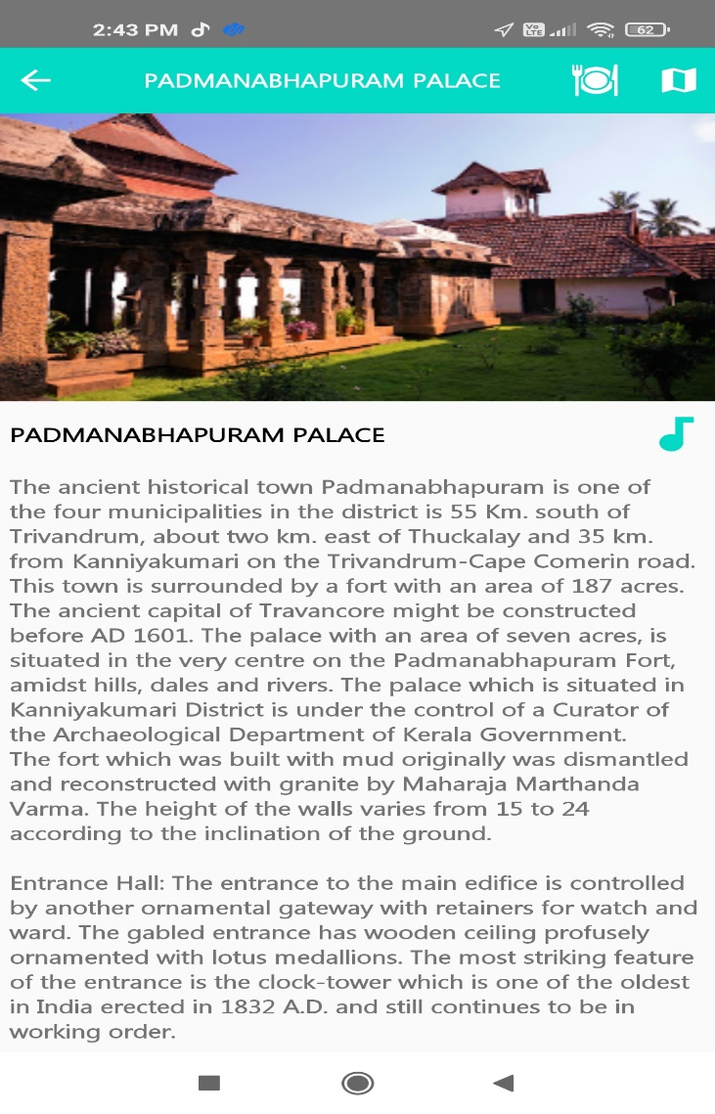
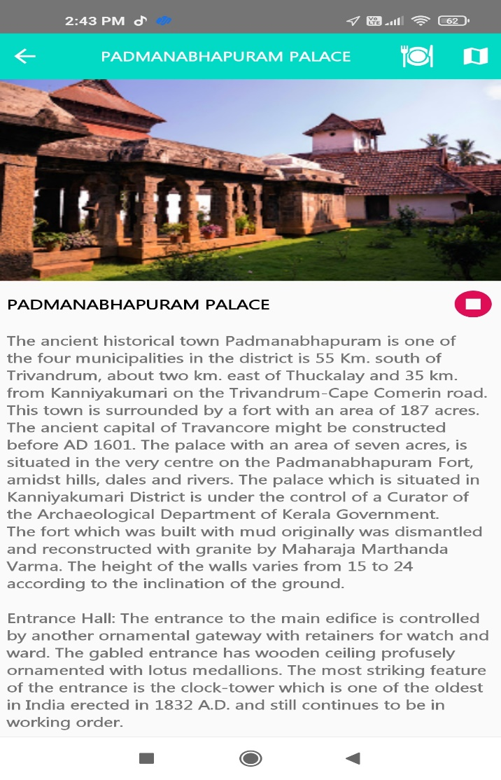
AUDIO AND INFORMATION ABOUT THE PLACES:

Slide 26
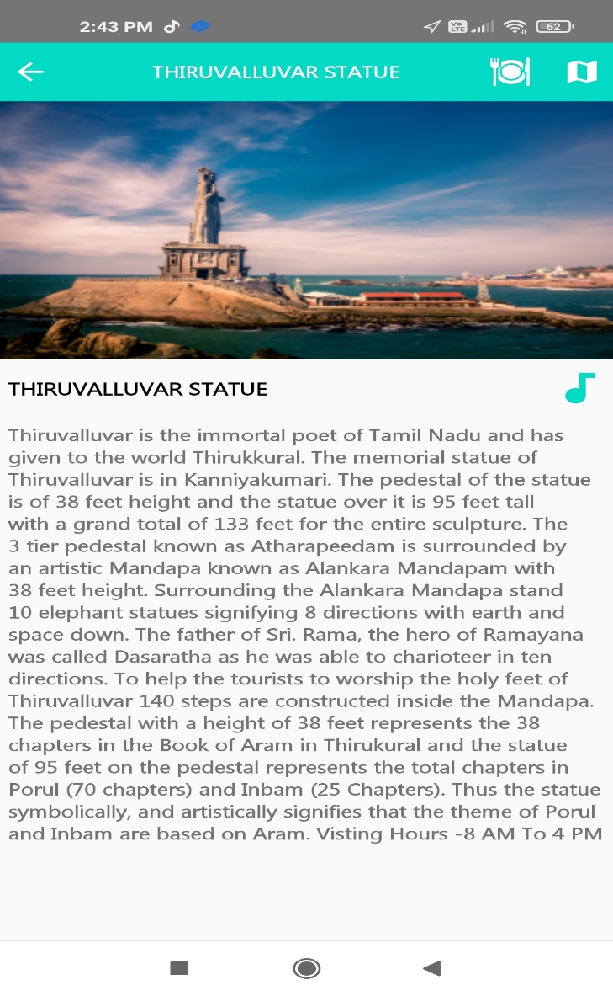

MAP:

Slide 27


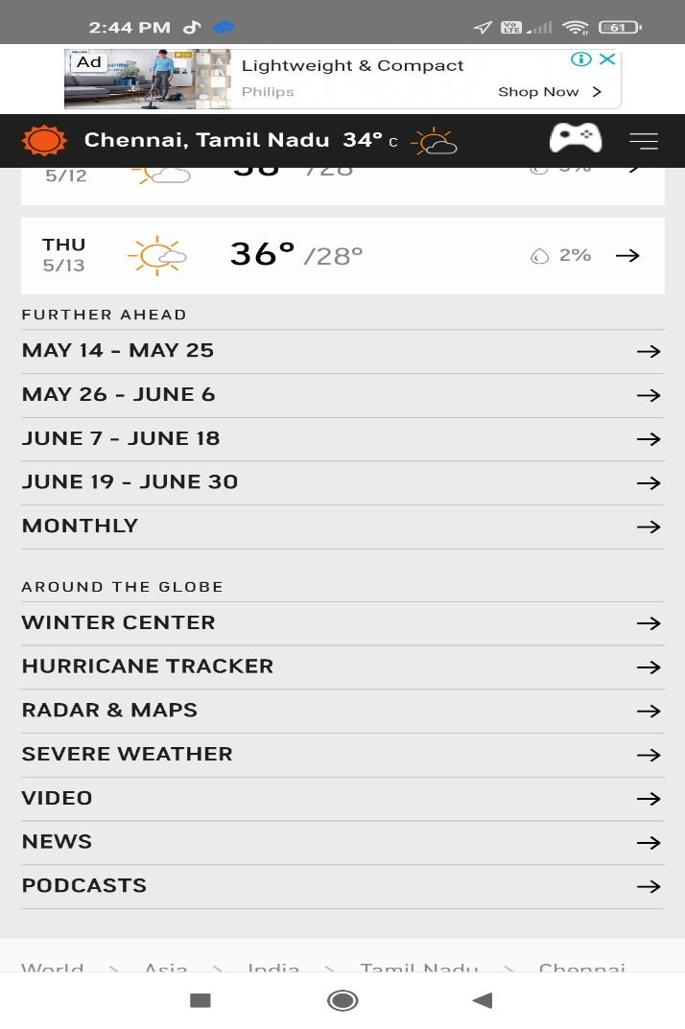
WEATHER:

Slide 28


RESTAURANTS:

Slide 29
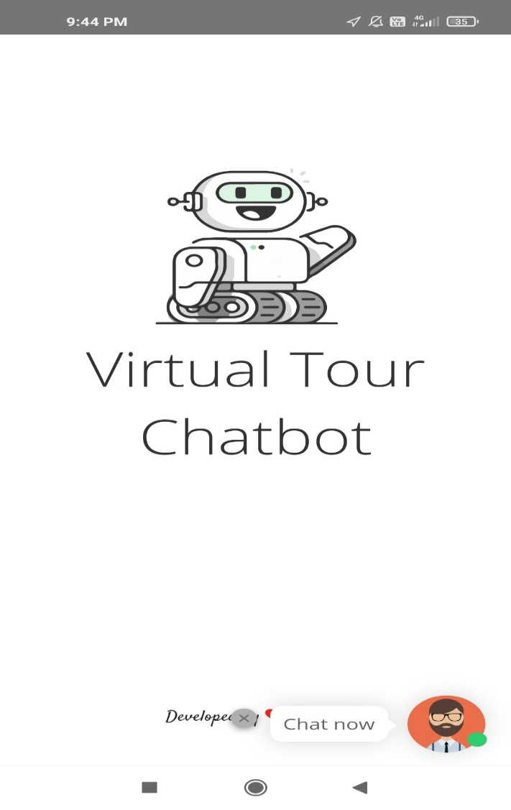
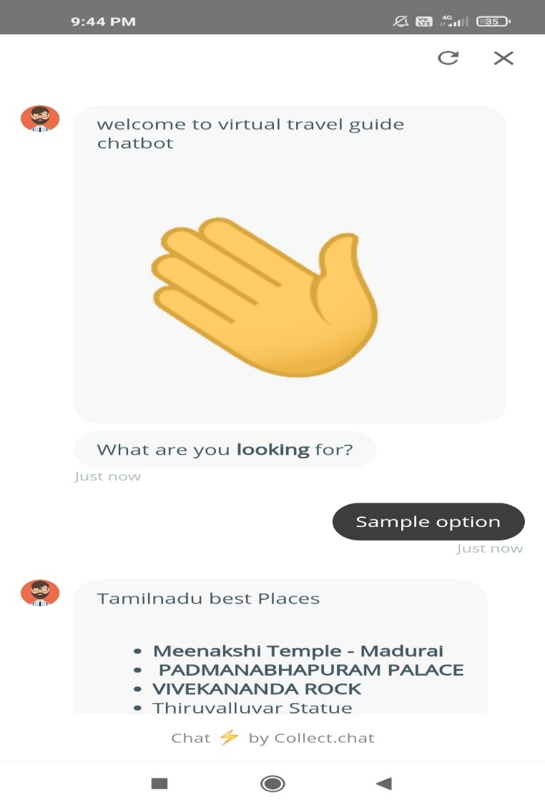
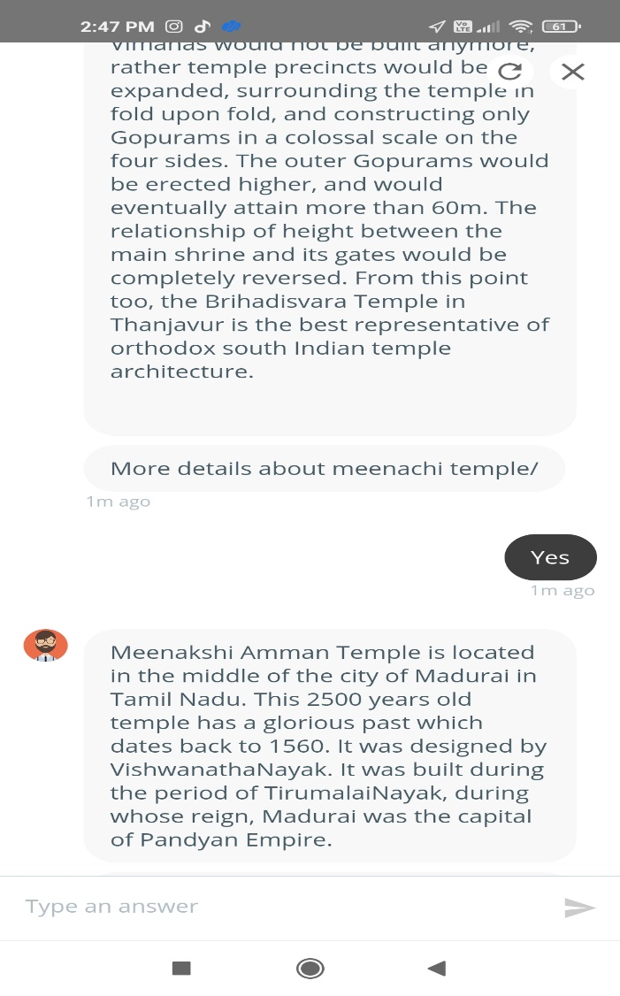
CHAT BOT:

Slide 30
CONCLUSION
In conclusion, this software will solve many problems in India relating to management of product and information pertaining to tourism.
Tourists will get acquainted with all the tourist sites in India and information pertaining to those sites without physically extracting information from people or having to travel long distances to see what the location has to offer.
With the availability of the Internet, users have access to the application; hence they are empowered with current and relevant information pertaining to tourism in India.
The application will go a long way in assisting tourists in decision making, and also as a source of revenue to the country.
This application will make tourism round the Indian country fun and easy because of easy access to relevant information.

Slide 31
PAPER PUBLICATION DETAILS
Journal Name: International Journal of Engineering Science And Computing.
Paper Title: Virtual Travel Guide (E-Bot) – A Detailed Information for Our Indian Monuments.
Published In: Volume 11 | Issue 4 | Year April-2021
Link:https://ijesc.org/upload/32066ca2f569b93d37e6b3a2f67a5b6a.Virtual%20Travel%20Guide%20(E-Bot)%20-%20A%20Detailed%20Information%20for%20Our%20Indian%20Monuments-converted.pdf

Slide 32
REFERENCE
N. T. Thomas, ``An e-business chatbot using AIML and LSA,'' in Proc. Int. Conf. Adv. Computing, Commun. Informat. (ICACCI), Sep. 2016,pp. 2740_2742.
2. V. Subrahmanian, A. Azaria, S. Durst, V. Kagan, A. Galstyan, K. Lerman, L. Zhu, E. Ferrara, A. Flammini, and F. Menczer, ``The DARPA Twitter bot challenge,'' Computer, vol. 49, no. 6, pp. 38_46, Jun. 2016.
3.G. Inc, The Road to Enterprise AI. Pune, Maharashtra: RAGE Frameworks, 2017.
4. P. Jackson and I. Moulinier, Natural Language Processing for Online Applications: Text Retrieval, Extraction and Categorization, vol. 5. Amsterdam, The Netherlands: John Benjamins, 2007,
5. M. Brambilla, M. Dosmi, and P. Fraternali, ``Model-driven engineering of service orchestrations,'' in Proc. IEEE Congr. Services, Los Angeles, CA, USA, Jul. 2009, pp. 562_569, doi: 10.1109/SERVICES-I.2009.94.
6. G. Daniel, J. Cabot, L. Deruelle, and M. Derras, ``Multi-platform chatbot modeling and deployment with the jarvis framework,'' in Advanced Information Systems Engineering (Lecture Notes in Computer Science), vol. 11483, P. Giorgini and B. Weber, Eds. Rome, Italy: Springer,Jun. 2019, pp. 177_193, doi: 10.1007/978-3-030-21290-2_12.
7. J. Masche and N.-T. Le, ``A review of technologies for conversational systems,'' in Proc. 5th ICCSAMA Conf. Springer, 2017, pp. 212_225.

Slide 33
THANK YOU

